Slide 1
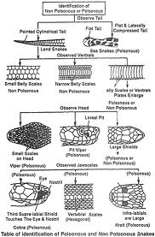

Slide 5
The longest of all living venomous snakes, the magnificent king cobra (Ophiophagus hannah) unique genus Ophiophagus, whose scientific name derives from the Greek for “snake-eating”, in reference to its dietary habits (5).The head is broad and flattened (2), while the neck features a narrow hood, which can be extended when individuals feel threatened (4). The body colour is typically tan, olive-brown or black, and may be marked with white or yellow chevrons at the anterior of the body, which become straight bands towards the rear (2) (5). These bands usually fade with age, and may disappear altogether, although some adults exhibit them throughout life (5).
In contrast to the normal hissing sound produced by most snake species in response to threats, the king cobra makes a distinctive growl, which emanates from the throat and deepens as the snake grows (6).

Slide 6
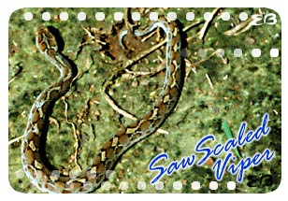

Slide 7
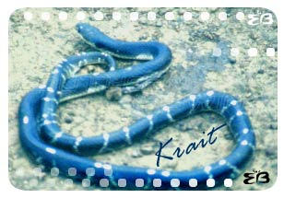

Slide 8
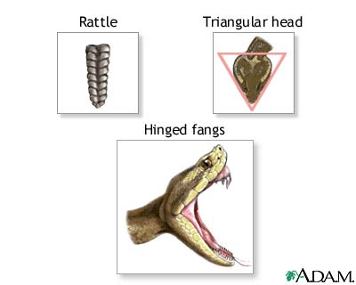

Slide 9
poisonous apparatus of pit viper

Slide 10
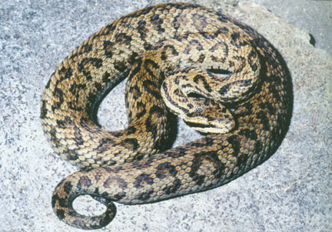
Himalayan Pit Viper (Gloydius himalayanus) Photo Credit: F. Tillack

Slide 11
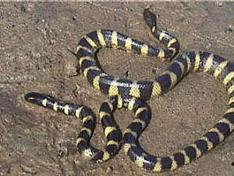
Hydrophis-sea snake

Slide 12
Coral snake

Slide 13
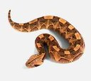

Slide 14
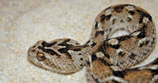
Echis carinata

Slide 15
REPTILIA Reptiles are ectothermic-cold blooded amniotes They originated from labyrinthodont amphibians gave rise to reptiles during the carboniferous period. Mesozoic era – Golden age of Reptiles

Slide 16
Reptiles lay cledoic eggs-(covered by calcareous shell-to allow the passage of air to provide oxygen) on land with extra embryonic membranes namely amnion, allantois,chorion & yolk sac extra embryonic membranes make the egg an independent` life support system’ amniotic egg

Slide 17
Key adaptations that led to the success of Reptiles 1.cledoic eggs 2.The evolution of `dry scaly skin’ to prevent water loss 3.Two pairs of pentadactyl limbs with clawed digits for moving on land 4.Pulmonary breathing & 5.Internal fertilization

Slide 18
Class REPTILIA includes the extinct dinosaurs(terrible lizards) & the extant chelonians,crocodilians,snakes, lizards & sphenodon Herpetology-The study of poikilothermic tetrapods.

Slide 19
General characters: 1.First true terrestrial,creeping or burrowing, amniotic tetrapods 2.Body-Head,neck,trunk & tail 3.skin-rough,dry.Exoskeleton-horny epidermal scales,shields,& claws 4.Dentition-acrodont,homodont & polyphyodont (thecodont- crocodiles as seen in the mammals) chelonians-edentate

Slide 20
5.Monocondylic Skull ,temporal fossae Each half of the lower jaw-six bones, procoelus vertebrae,first two cervical vertebrae-atlas & axis two sacral vertebrae. 6.respiration-lungs;they use ribs & intercostal muscles in ventilation(this feature developed for the first time) gaseous exchange takes place through vascular cloacal wall in turtles

Slide 21
7.Heart- incompletely 4 chambered except in crocodiles- 4 chambered. sinus venosus is present,conus arteriosus absent three(3) aortic arches arise directly from ventricle(pulmonary,right &left systemic arches). erythrocytes nucleate.

Slide 22
8. metanephric kidneys, mesonephric duct(Wolfian duct) of the embryo functions as vasdeference in the males. Uricotelic(uricotelism an adaptation to conserve water) Cloaca is divided into coprodaeum, urodaeum and proctodaeum

Slide 23
9.12 pairs of cranial nerves snakes -10 pairs of cranial nerves Tympanic membrane-found at the inner border of the external auditory meatus. Middle ear has single ear ossicle called columella auris Jacobson’s organs-specialised olfactory structures highly developed in lizards & snakes

Slide 24
10.Males usually possess a muscular copulatory organ, except in Rhyncocephalians. lizards & snakes have a pair of hemipenes 11.cloaca- 3 chambered as seen in birds anterior-coprodaeum middle-urodaeum posterior-proctodaeum

Slide 25
12.Fertilization internal;oviparous some snakes-viviparous eggs –megalecithal & cledoic Cleavage-meroblastic & discoidal During development extra embryonic membranes namely amnion, allantois,chorion & yolk sac are formed as in birds & mammals

Slide 26
Order:Chelonia: 1.called as turtles(marine) ,terrapins (fresh water) and tortoise(moist land) 2.body is short and broad 3. limbs are paddle like in aquatic 4.body is enclosed in a shell .It consists of dorsal carapace &ventral plastron. 5.skull is anapsid,procoelous vertebrae, sternum is absent 6. jaws are edentate and covered by horny sheath

Slide 27
7.clavicles,interclavicle and abdominal ribs fused with plastron 8 ductus botalli is present 9. cloacal aperture is longitudinal 10. males posses a single penis 11. all are oviparous 12.cloacal respiration found in turtles 13.longest life span 14. Single nosal opening is present

Slide 28
Extant Reptiles -grouped into 4 orders 1.Chelonia-Chelone – marine green turtle,Testudo(Terrestrial form),Trionyx (fresh water form),Dermochelys(leather back turtle) 2.Rhyncocephalia–Sphenodon (a`living fossil’,endemic to Newzealand) 3.Crocodilia –Crocodylus palustris(Indian Crocodile or maggur), Alligator (alligator) Gavialis gangeticus(Indian Gavial or gharial) 4.order:Squamata: Lizards &snakes

Slide 29
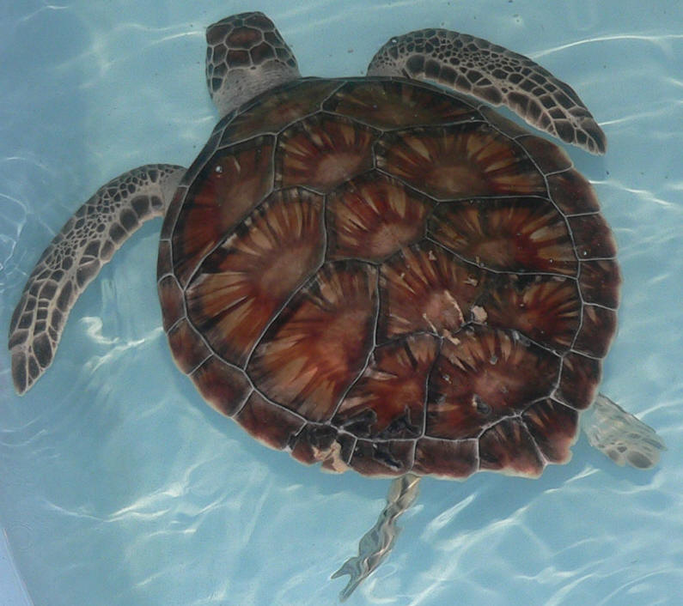
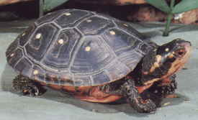
C
H
E
L
O
N
E
M
Y
D
A
S
Notes:
Chelone mydas

Slide 30
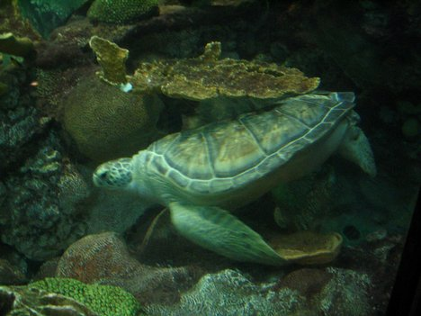
TESTUDO

Slide 31
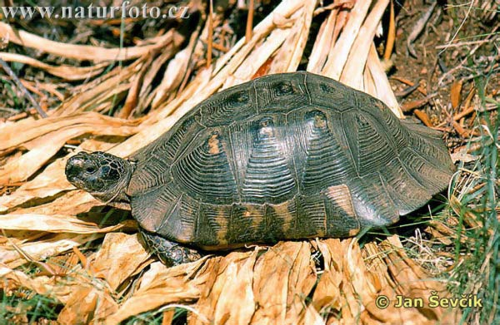
TESTUDO

Slide 32
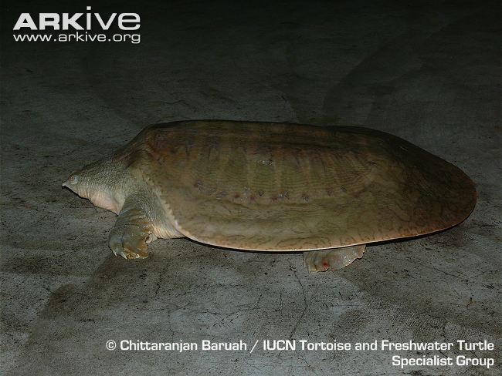
Trionyx - fresh water form

Slide 33
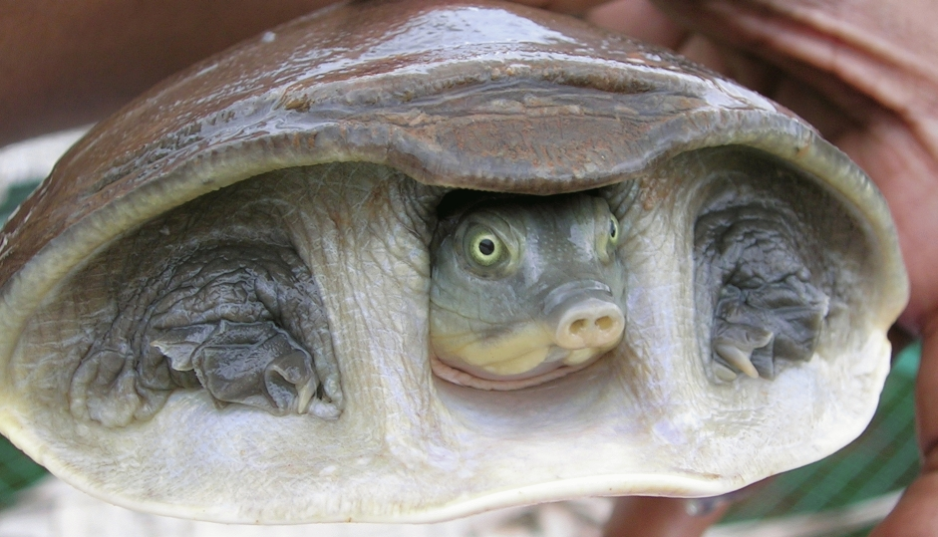
Trionyx fresh water form

Slide 34
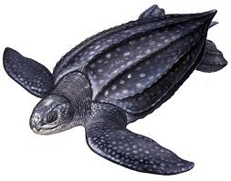
DERMOCHELIS
Notes:
Dermochelis

Slide 35
Order: Rhynchocephalia 1.Sphenodon is the oldest living and considered as Living fossil 2. Endemic to New Zealand and commonly known as tautara or hatteria lizard. 3. Body is lizard like 4.Skin is scaly and scales on mid dorsal line form a crest, olive green 5. Limbs are relatively weak

Slide 36
6. Skull is diapsid and vertebrae are amphicoelous 7.Proatlas is present 8.Sternum and abdominal ribs are present 9. Ribs are single headed and they bear uncinate process. 10.Dentition is acrodont and monophyodont

Slide 37
11. A well developed penial or parietal is present and sensitive to light 12 .Cloacal aperture is tranverse 13. Copulatory organ is absent. Urinary bladder is present. 14. Oviparous. 15.Insectivorous,carnivorous and nocturnal Ex:Sphenodon

Slide 38
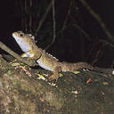
sphenodon punctatus

Slide 39
Order:Crocodilia; 1.includes crocodiles, alligators, caimans and gavialis 2. largest living fresh water reptiles 3.Body is covered by bony plates(scutes) which are overlapped by horny epidermal plates

Slide 40
4.Feet are webbed. Foer limbs are shorter than hind limbs 5. Tail is long.strong and laterally compressed,oar shaped,help in swimming 6.Jaws are elongated & teeth are thecodont 7. Diaphragm present between thoracic & abdominal cavities

Slide 41
8. Skull is diapsid. Procoelous verte brae, proatlas is present 9. Ribs are double headed with capitulum &tuberculum 10.Thoracic ribs posses uncinate processes. Abdominal ribs present 11.Clavicles absent.Interclavicle present 12.Nostrils are situated at the tip of snout

Slide 42
13. Heart is 4 chambered. Foramen of panizza connects the left & right sustemic arches 14. urinary bladder is absent. Cloacal aperture is longitudinal. 15.Single copulatory organ is present. 16. All are oviparous.Eggs are hard shelled EX: Crocodylus, Alligator, Caiman, Gavialis

Slide 43
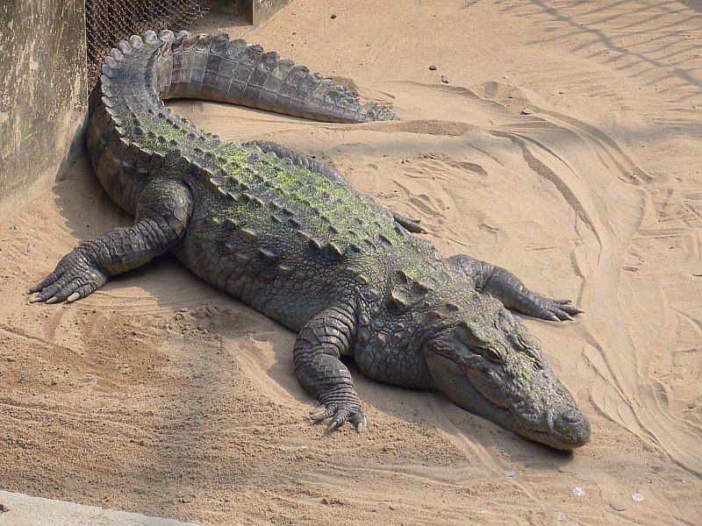
Crocodylus palustris

Slide 44
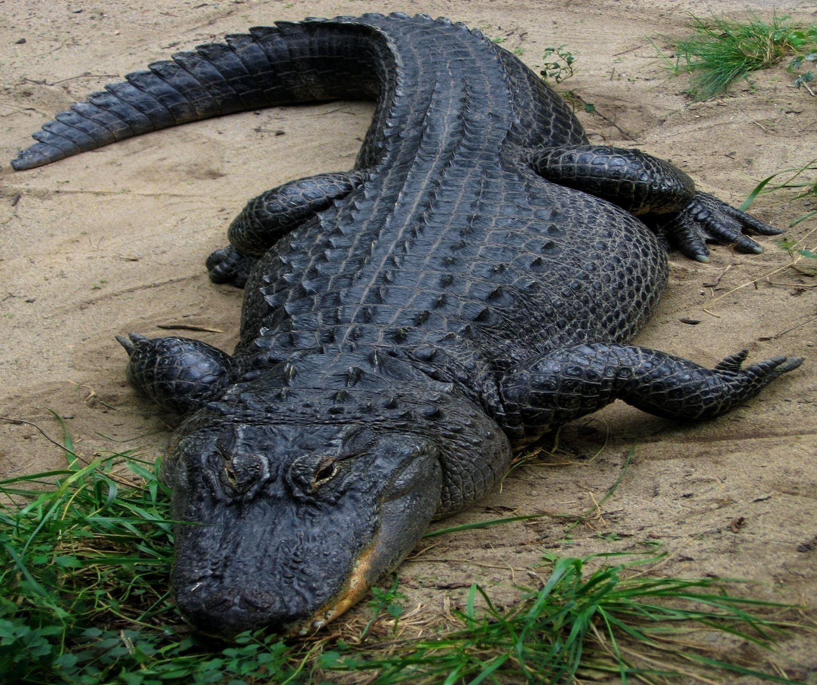
Alligator (alligator)

Slide 45
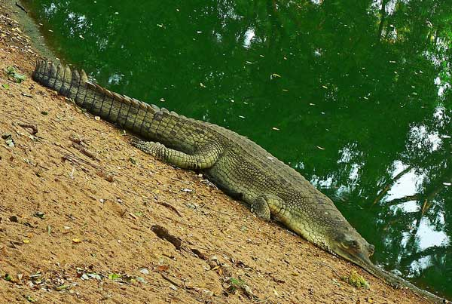
Gavial or gharial

Slide 46
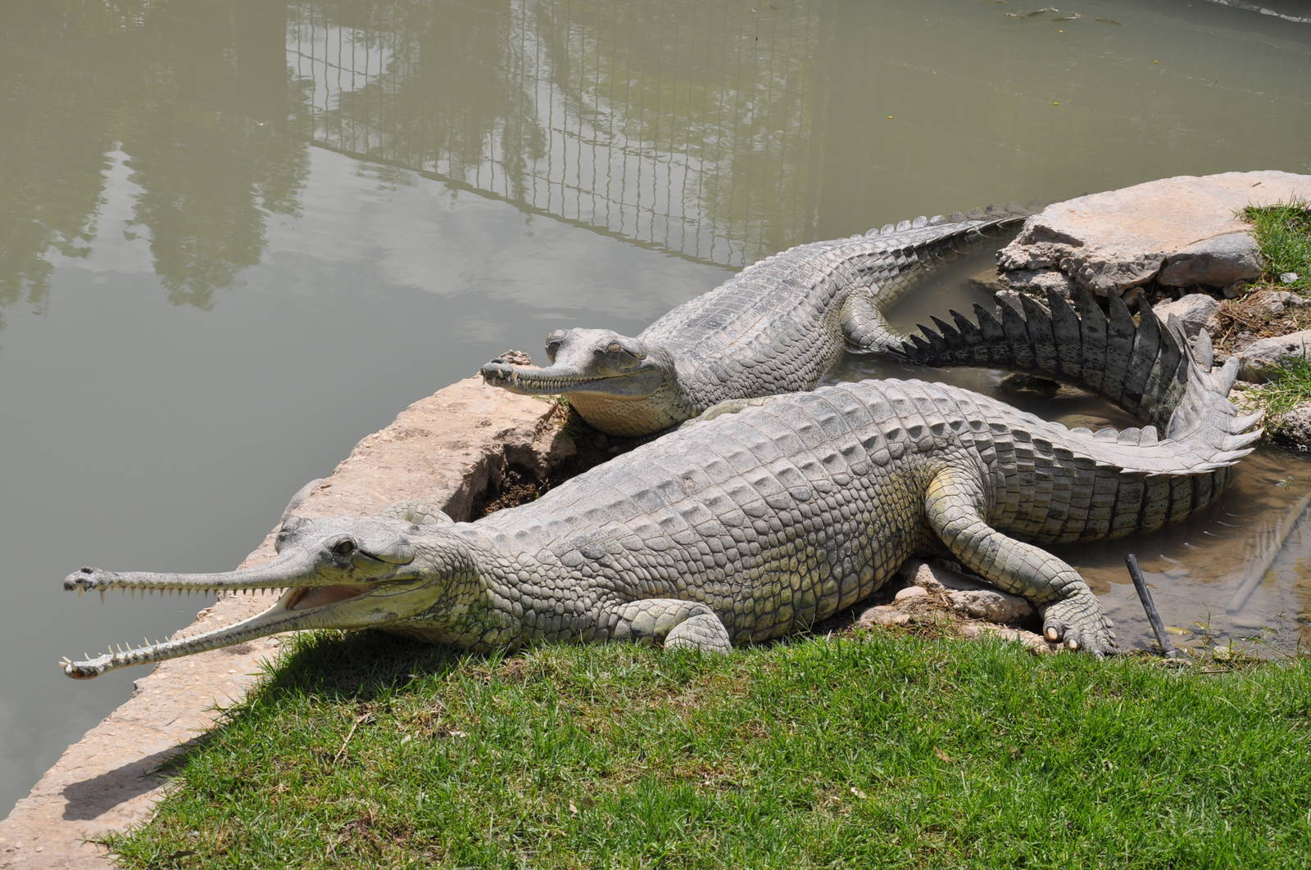
Gavialis gangeticus(Indian Gavial or gharial)

Slide 47
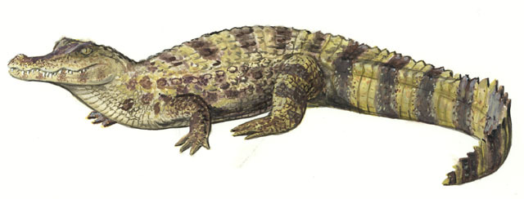
CAIMAN
Notes:
Caiman

Slide 48
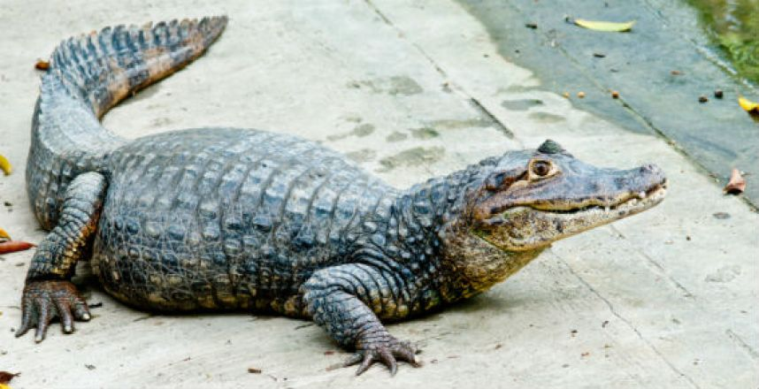
CAIMAN

Slide 49
4.Squamata Lizards :Hemidactylus (wall lizard), Chameleon, Draco(flying lizard) Snakes: Poisonous Snakes:Naja naja(cobra), Ophiophagus hanna(king cobra), Bungarus (krait)Daboia/Vipera russelli(chain viper) Non-poisonous Snakes:Ptyas(rat Snake,) Tropidonotous(grass snake or pond snake)

Slide 50
Order:Squamata: 1.includes lizards &snakes 2. largest order of living reptiles. Most successful modern reptiles 3. body is covered by horny epidermal scales 4.Skull is modified diaspid type. Procoelous vertebrae 5. Dentitionis acrodont or pleurodont 6.cloacal aperture is trasverse

Slide 51
7.Males posses a pair of hemipenes 8. mostly oviparous, some are viviparous two suborders 1.Lacertilia 2.Ophidia

Slide 52
Suborder: Lacertilia: 1. includes lizards 2.fore and hind limbs are present,bearing clawed digits (except Barkudia) 3. Eye lids are movable. 4. Tympanum present 5.T-shaped interclavicle present 6.Quadrate is immovable.sternum and episternum are present

Slide 53
7.Ductus caroticus present which connecting systemic and carotid arches 8.many lizards exhibit caudal autotomy 9. tongue is entire 10.parietal eye is present 11. Urinary bladder is present

Slide 54
EX: Calotes, Hemidactylus, Draco, Chameleon, Varanus,Uromastix, Mabuya, Barkudia

Slide 55
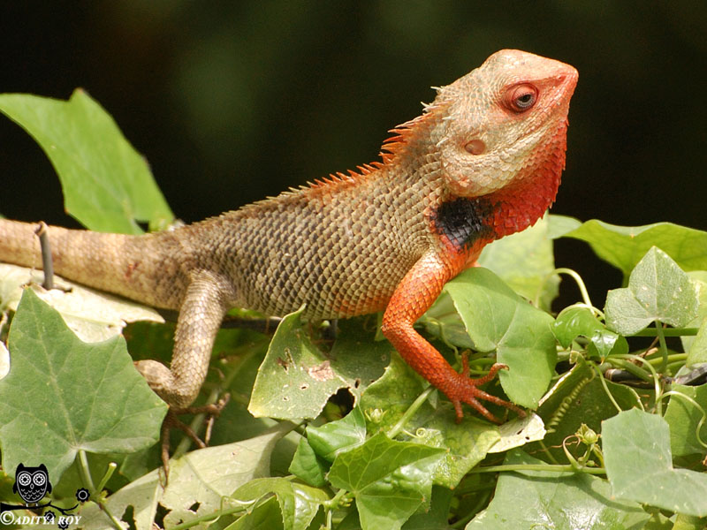
Calotes
Notes:
Calotes

Slide 56
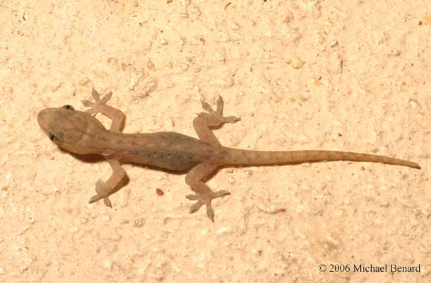
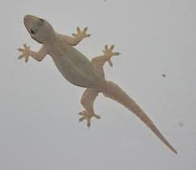
Hemidactylus (wall lizard),

Slide 57
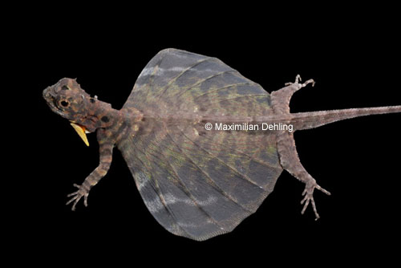
Draco(flying lizard)

Slide 58
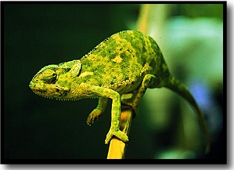
chameleon

Slide 59
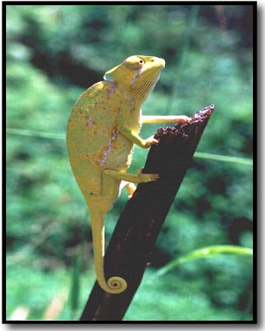

Slide 60
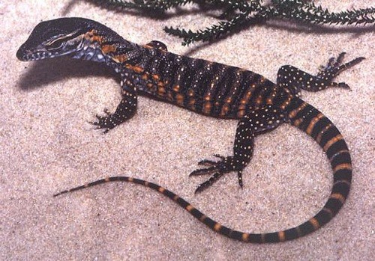
Varanus
Notes:
Varanus

Slide 61
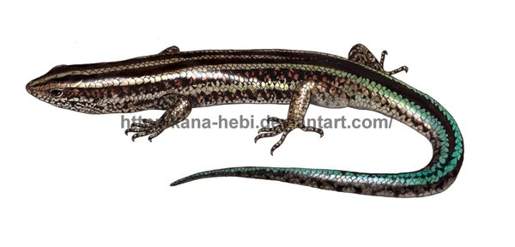
Mabuya
Notes:
Mabuya

Slide 62
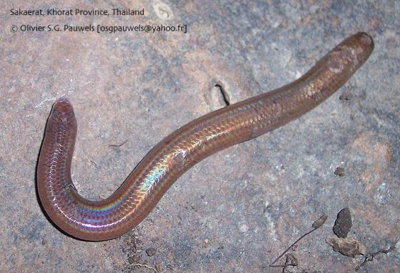
Barkudia
Notes:
Barkudia

Slide 63
Sub order: Ophidia: 1.Includes snakes 2.body is covered by scales. Moulting occurs several times 3. limb and limb girdles are absent 4. sternum and episternum absent 5. tympanic membrane and middle ear cavity are absent 6. two halves are united by a ligament

Slide 64
7.Eye lids are immovable 8. tongue is bifid and ptotrusible 9.lungs,kidneys and gonads are asymmetrical 10. urinary bladder is absent 11. 10 pairs of cranial nerves EX:Naja, Naja hannah, Bungarus, Russel,s viper, Hydrophis, Enhydrina, Echis, Hemibungarus, Typhlops, Python, Eryx, Tropidonotus

Slide 65
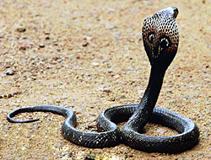
Naja naja
Notes:
Naja naja

Slide 66
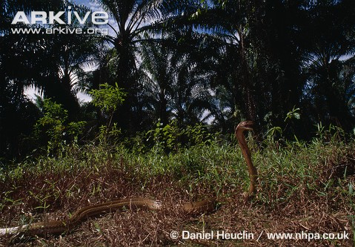
Ophiophagus hanna

Slide 67
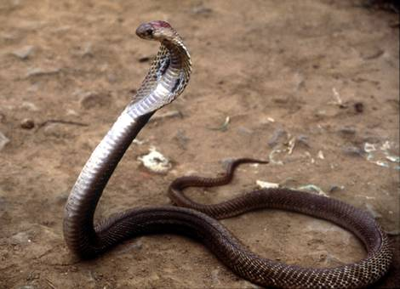
Ophiophagus hanna(King cobra)

Slide 68
Bungarus cerulius

Slide 69
bungarus perulius

Slide 70
Russels viper

Slide 71
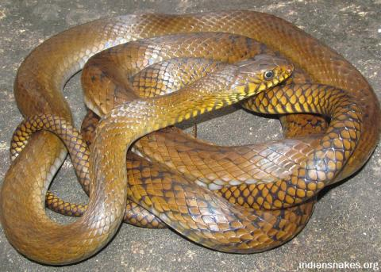
Ptyas(rat Snake,)

Slide 72
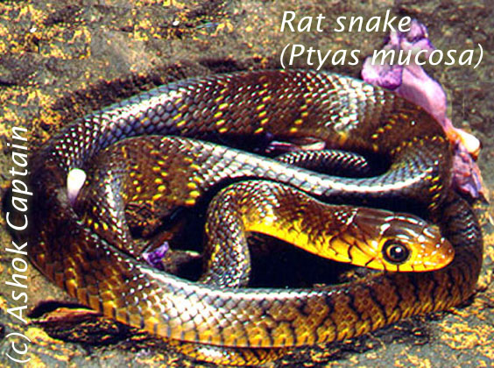

Slide 73
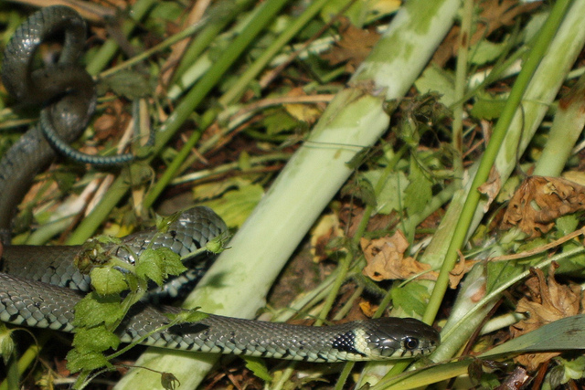
Tropidonotous(grass snake or pond snake)

Slide 74
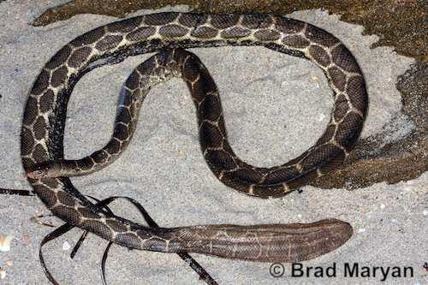
Hydrophis
Notes:
Hydrophis

Slide 75
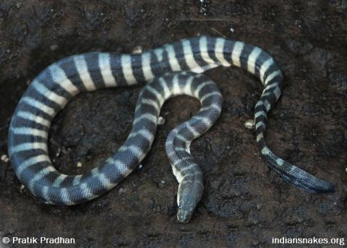
Enhydrina
Notes:
Enhydrina

Slide 76
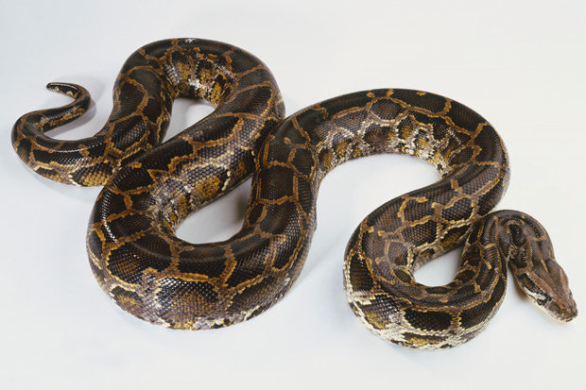
Python
Notes:
Python

Slide 77
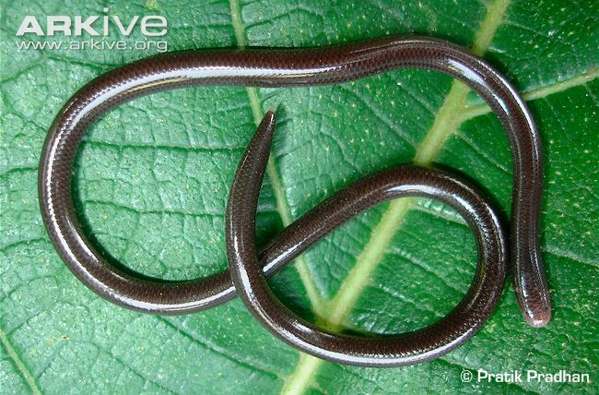
Typhlops
Notes:
Typhlops

Slide 78
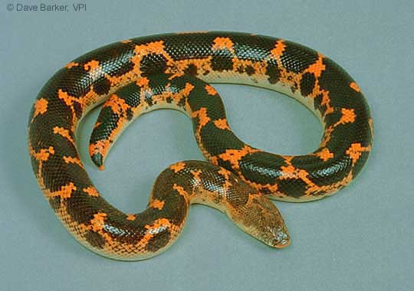
Eryx
Notes:
Eryx

Slide 79
