Slide 1
Cepalochordata
General characters

Slide 2
1. Looks like Lance eel,hence named as lancelets
2. marine forms
3. body is small, fish like and translucent
4.Typical chordates,like notochord,gillslits and a dorsal tubular nerve chord are present
5.skull is abesent,hence they are called as Acrania

Slide 3
6.Notochord &nerve cord present throughout life and persist in the adult
7.Median fins are present. paired fins are absent
8.dorsolateral muscles are thick and segmented into myotomes
9.Notochord extends from posterior end to anterior end of the body ,beyond the nerve cord. Hence the name Cephalochordata

Slide 4
10.Pharynx is surrounded by atrium which opens out by atrial aperture
11.gillslits ,proto nephridia and gonads open into atrium
12.Endostyle is present on the ventral wall of the pharynx
13.respiratory organs are absent respiration by diffusion
14.circulatory system is closed type
15.Heart,blood cells and respiratory pigment are absent

Slide 5
16.Oral hood ,wheel organ are the characteristic features. Ciliary feeders. Alimentary canal is straight& hepatic diverticulam is present.
17. excretion by paired segmented protonephridia
18.Brain and sense organs are absent
19.sexs are separate
20.many pairs of segmented gonads present

Slide 6
21. Gonoducts are absent
22.fertilisation is external 23.development is indirect and
Includes a free swimming larve which exhibits progressive metamarphosis. ex:1.Branchiostoma(Amphioxus)
2.Asymmetron.

Slide 7
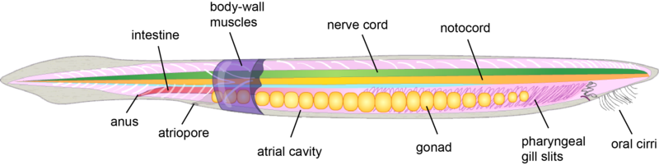
AMPHIOXUS
Notes:
AMPHIOXUS

Slide 8
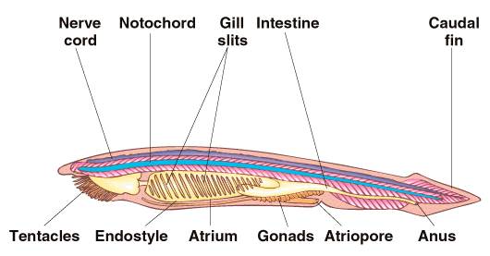
AMPHIOXUS

Slide 9
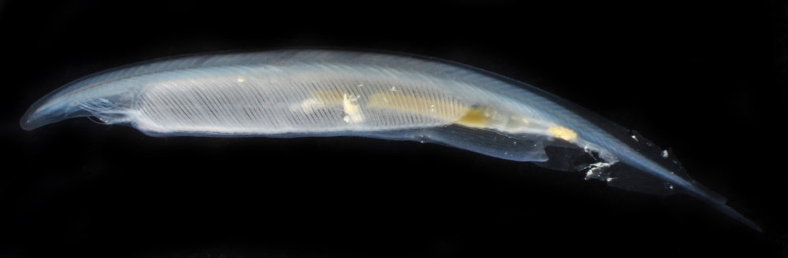
Asymmetron.

